Slide 1

Predicting Mortgage Loan Approval
Group 9

Slide 2
Business Problem
How Does P2P Lending Works?
The general context for a P2P loan lender company is that it operates as a third-party company between borrowers and investors. Each stakeholder benefits from the business as the borrower can leverage its loan terms and with every disbursed loan amount, the investors and P2P lender earn its revenue. Moreover, having bad credit customers will cause revenue losses for the P2P lenders. [1]
The Business Problem
We have a P2P loan lender company specializing in mortgage loans in this business approach. Assumingly, the marketing department has decided to run a marketing campaign to retain the potential customers that have visited the website and shown interest in applying for a mortgage loan. However, it is not worthwhile to target all the customers as there might be high-risk customers with a low probability of getting disbursed loans. Therefore, the company wants to target the potential customers that are more likely to get disbursed loans, which also optimizes its contribution margin, i.e., minimize the marketing costs and maximize the revenue.
[1]. Kagan, J., 2022. What Is Peer-to-Peer (P2P) Lending? Definition and How It Works. [online] Investopedia. Available at: <https://www.investopedia.com/terms/p/peer-to-peer-lending.asp> [Accessed 8 October 2022].

Slide 3
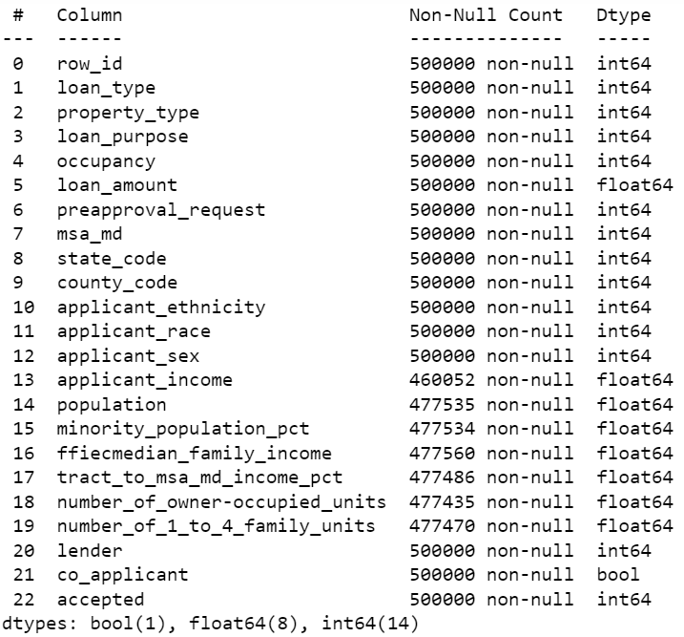
Data Understanding
Overview
500 000 observation, 23 columns
21 features
Target variable: accepted
Changed confusing column name preapproval to preapproval_request
General
Data Type
Categorical (14)
Numerical (8)
Bool Type (1)
Explanation
Loan-related: type, amount, lenders, etc.
Applicant-related: ethnicity, races, income, etc.
Property-related: location and census info
Other: row_id and target variables
Issues
Missing values coded as -1 (green box)
Null values (blue box)
Skewed values

Slide 4
Data Understanding
Exploratory Data Analysis
Removing irrelevant features
Redundant variable: row_id and location-based variables: msa_md and county_code
Remove variables that describes msa_md: ffiecmedian_family_income, tract_to_msa_md_income_pct
Lenders: no description for each lender id were given and the categorical variable put a heavy workload on CPU
Treating missing values
Filling missing census data with the median (applicant_income, population, minority_population_pct)
Removing rows with missing state_code values since all the features related to the missing state_code values were also missing and then filled missing census data with median value that are related to a specific state_code
One-hot encoding
Create dummy variables for the categorical features and converting bool type to integer

Slide 5
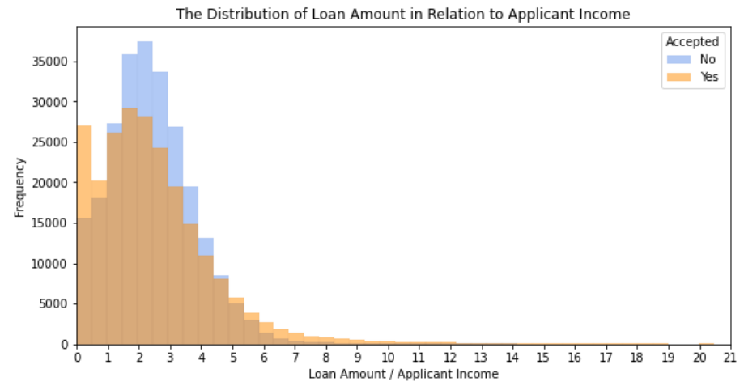
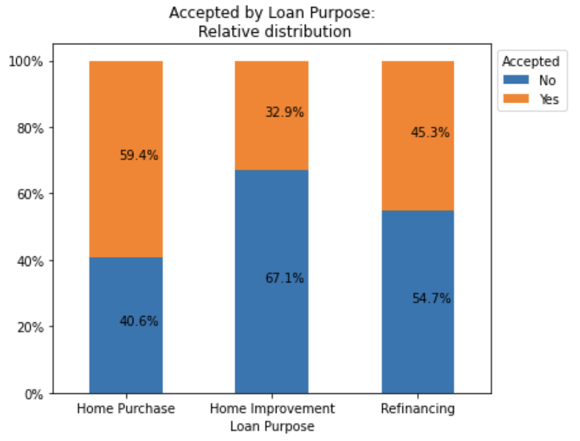
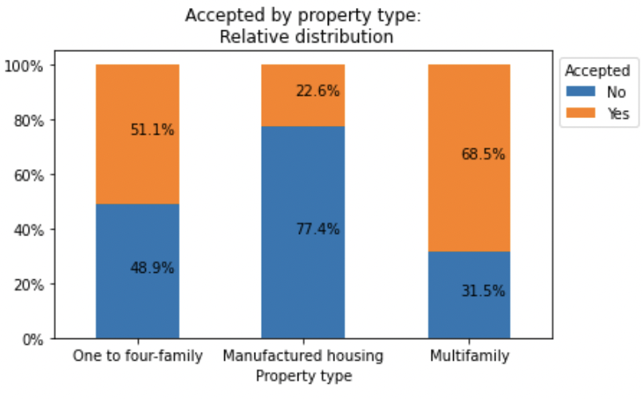
Descriptive analysis
Application Information
From the distribution of loan amount in relation to the applicant income, we see that on average, loan amounts that are higher than the applicant’s yearly income get rejected more. Therefore, we create a new variable that describes the ratio between the applicant income and loan amount
Applications for home improvement have the lowest acceptance rate while applications for home purchase have the highest acceptance rate
It seems that there’s a high probability of getting the loan rejected from manufactured housing. This could be due to the fact that these loan types are not federal-insured [1].
It is good to note that both features describing applicant income and loan amount are highly right-skewed, which may introduce bias in our binary classification problem.
[1]. Kpew.org. (2022). Lenders Deny More Than Half of Loan Applications for the Purchase of Manufactured Homes. [online] Available at: https://www.pewtrusts.org/en/research-and-analysis/white-papers/2022/02/lenders-deny-more-than-half-of-loan-applications-for-the-purchase-of-manufactured-homes [Accessed 22 Oct. 2022].
Notes:
Based on the distribution

Slide 6
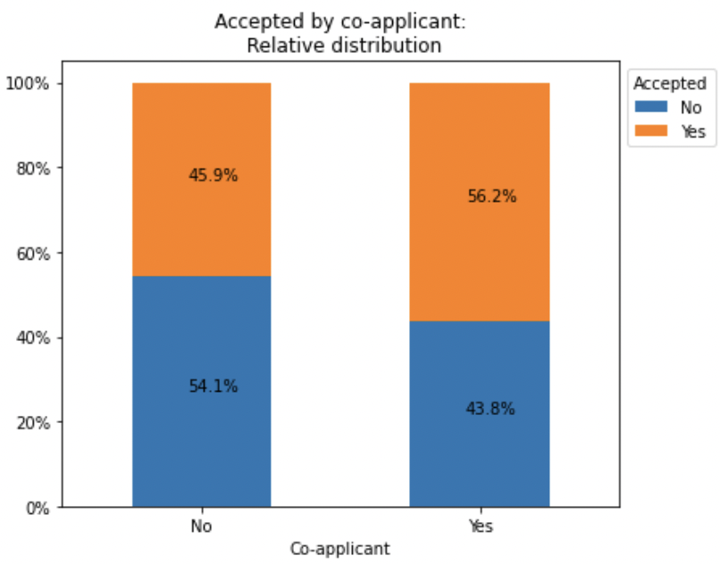
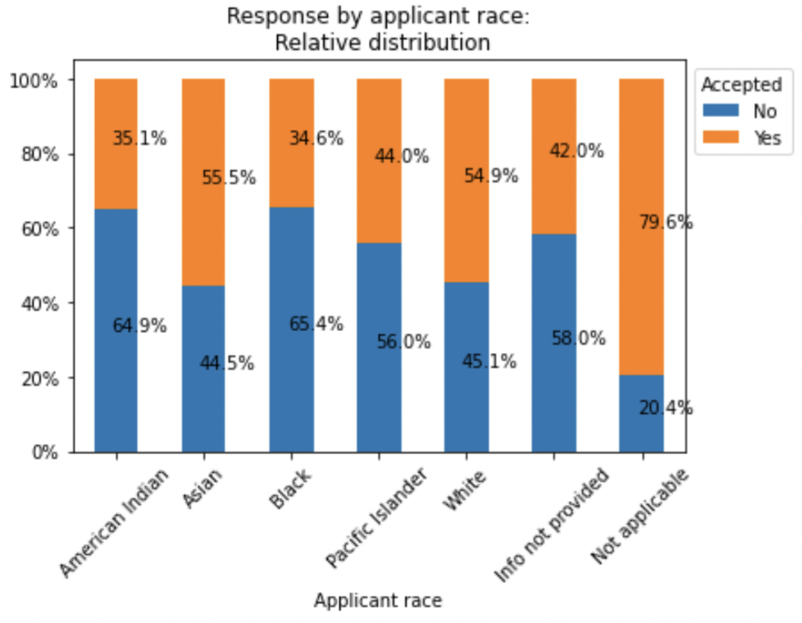
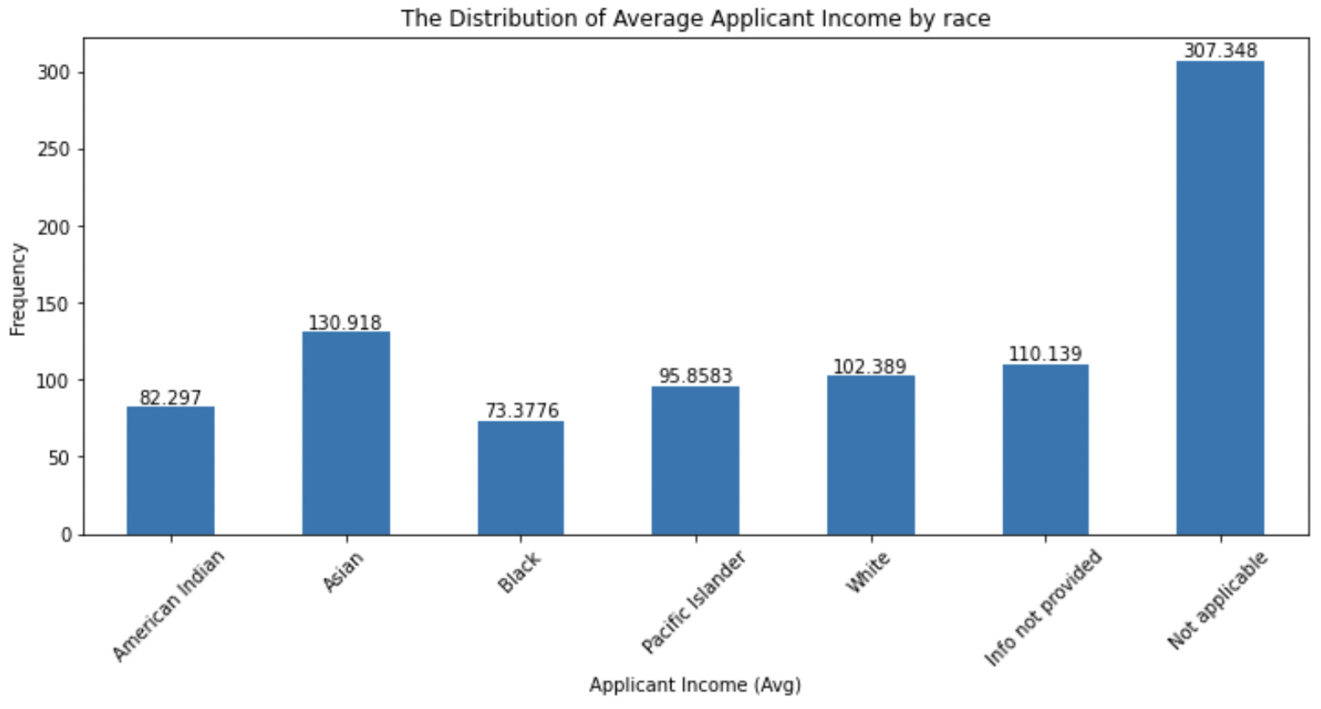
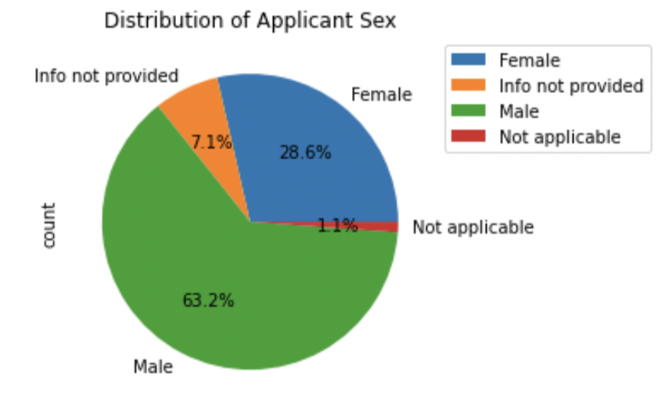
Descriptive analysis
Applicant Background
Those who do not have a co-applicant have a lower probability of getting their loan applications accepted, therefore the variable seems to be a good indicator for our model
Most of the applicants are male (63%)
Black or African American as well as American Indian applicants have a higher probability of getting their loan applications rejected. However, when taking a closer look, they also have a lower average income
⇒ Therefore, it seems that applicant race, gender and ethnicity are not good indicators for our model. Furthermore, keeping the ethical questions in mind, we don’t want the model to start discriminating these groups, which is why these features are dropped

Slide 7
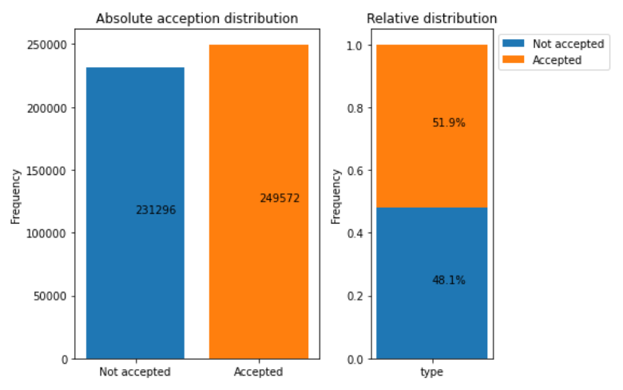
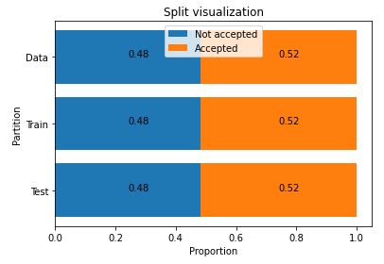
Descriptive analysis
Balance of the Dataset
We split the data to training and testing sets with 70/30 ratio
After the split the distribution of the accepted and not accepted applications remains the same, so the split was successful
The data is already almost balanced, so there is no need to re-balance the data

Slide 8
Predictive Analysis
The Process of Modeling the Business Problem
With the business problems in mind, we try to achieve the highest hit rate, which is our main driver for choosing and tuning the model. We also try to simulate the expected value for the business-wise outcome.
Fit 5 models
Performance Comparing
Performance Improving
Cross-validation
Decision Trees
Logistic Regression
Random Forest
The accuracy is not very high, ranging from 60 – 67%
Tree-based model has better recall score
Simulate business outcome with Expected Value Framework
Adding back some features
Hyper-parameter tuning based on recall scores
(Feature selection)
Run 10-fold cross validation
Mean accuracy: 67%
Mean recall: 73%
2 boosted tree-based models
XGBoost
CatBoost
Notes:
compare models: , confusion matrix, expected value calculation, AUC, ROC curve
improving:
tuning parameter - GridSearchCV, feature selection: lasso shrinked all coefficients to 0, cross validation
recall = the model’s ability to correctly predict the positives out of actual positives

Slide 9
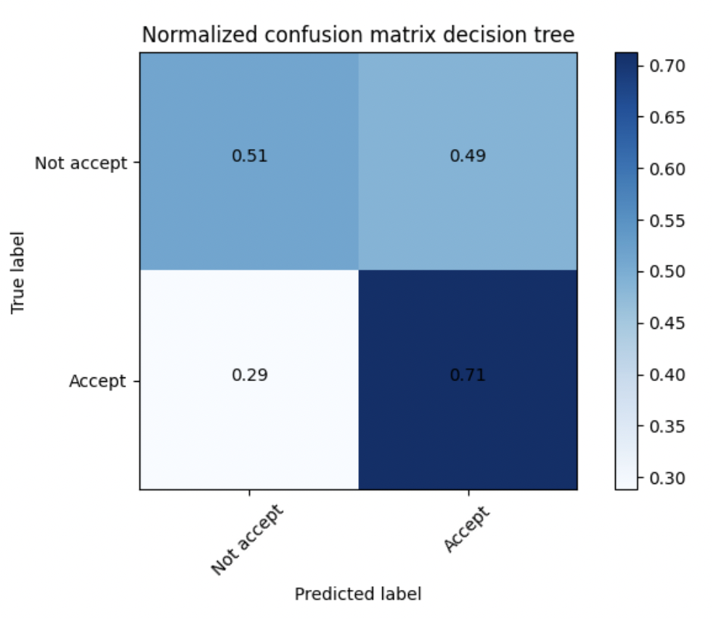
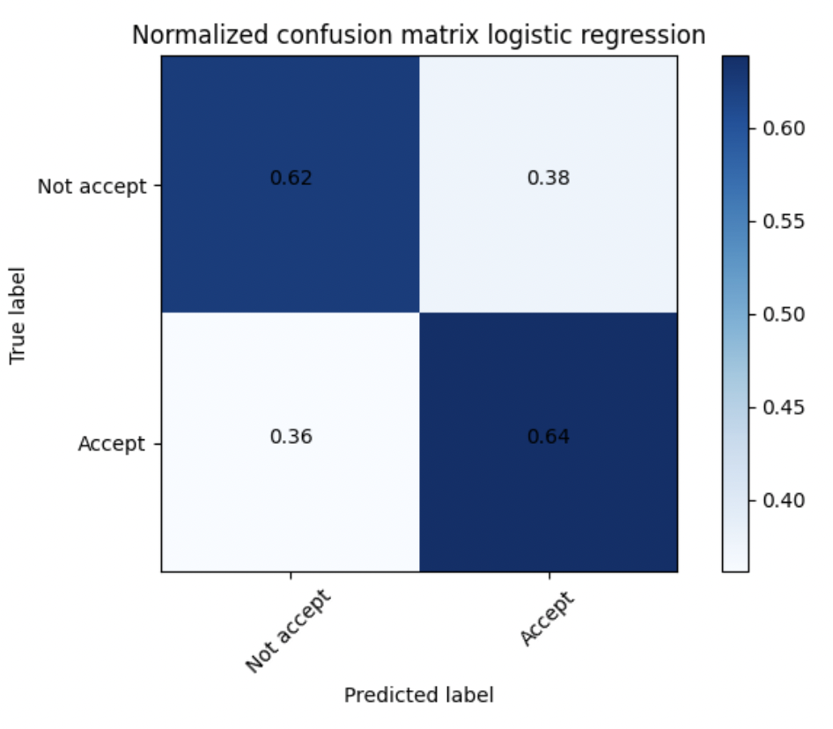
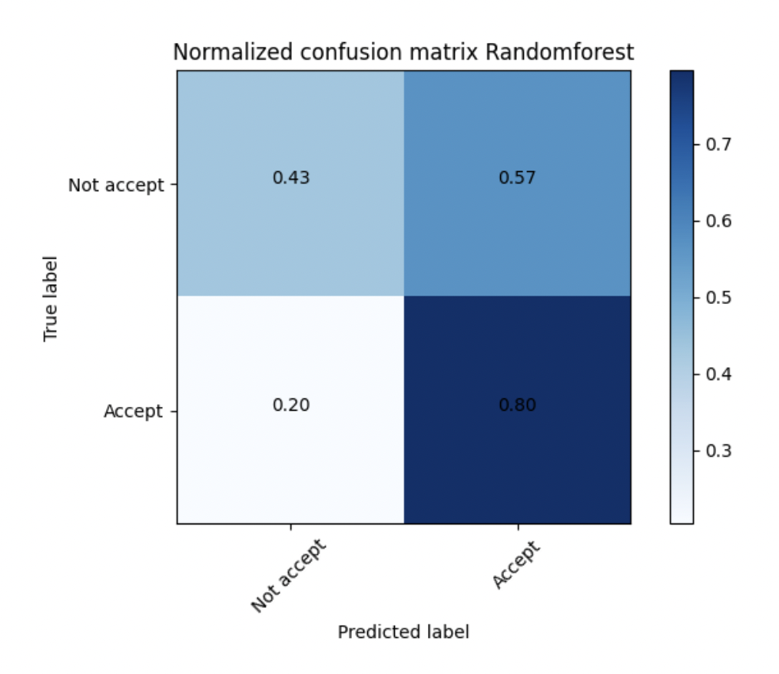
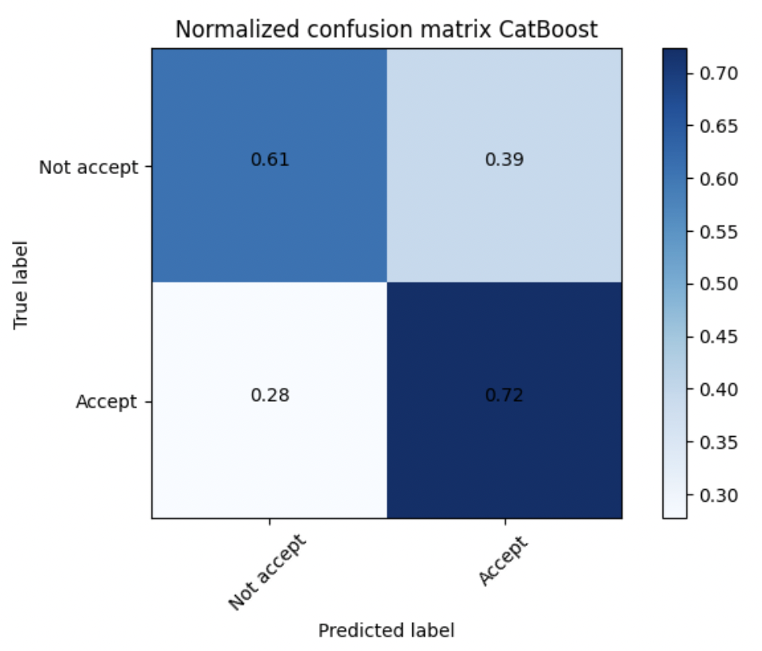
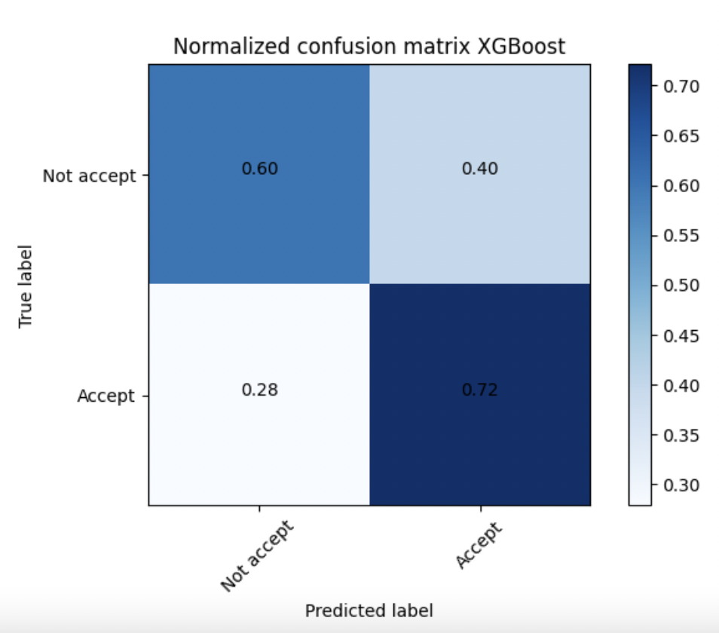
Predictive Analysis
Model performance
Model | Hit rate
Decision Tree | 71%
Logistic Regression | 64%
Random Forest | 80%
XGBoost | 72%
CatBoost | 72%

Slide 10
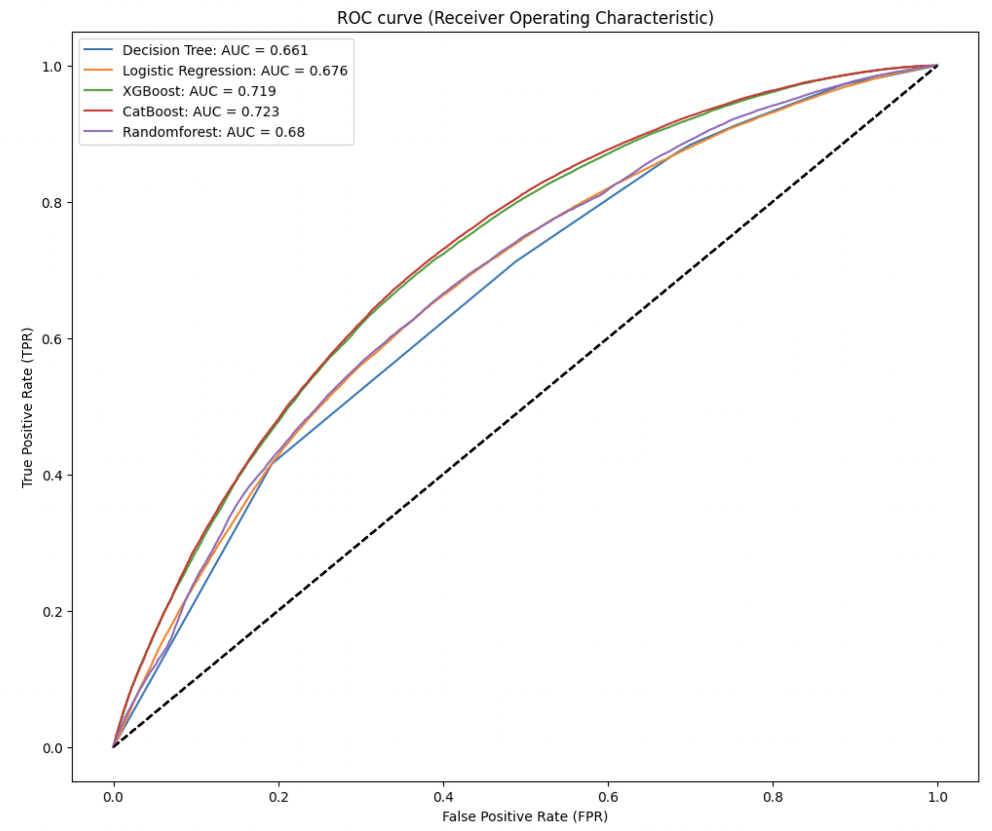
Predictive Analysis
Model performance
In general
Tree-based models have a better performance on recall and accuracy
Boosted decision trees have better performance on recall
The performance of XGboost and Catboost models are similar to each other and they also yield best accuracy scores. However, our main objective in the business problem is to target only those customers who will have a high probability of getting mortgage loan approvals. Therefore, our aim is to have an increased hit rate and from the confusion matrix, it can be observed that Random Forest model yields the highest TP rate of 80%
Notes:
accuracy = correct predictions / total predictions

Slide 11
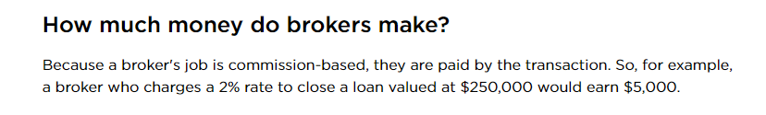
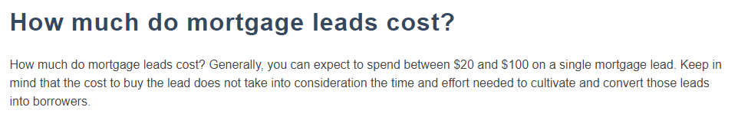
Predictive Analysis
Simulate the Business Outcome with Expected Value Framework
Cost
Average lead fee / Lead conversion rate
25 / 0.1 = 250$
[1]
Benefit
Median loan amount x 2% - cost
162 000 x 2% - 250 = 2990$
[2]
Model | Business outcome
Decision Tree | 1046$ / per customer
Logistic Regression | 946$ / per customer
Random Forest | 1167$ / per customer
XGBoost | 1071$ / per customer
CatBoost | 1075$ / per customer

Slide 12
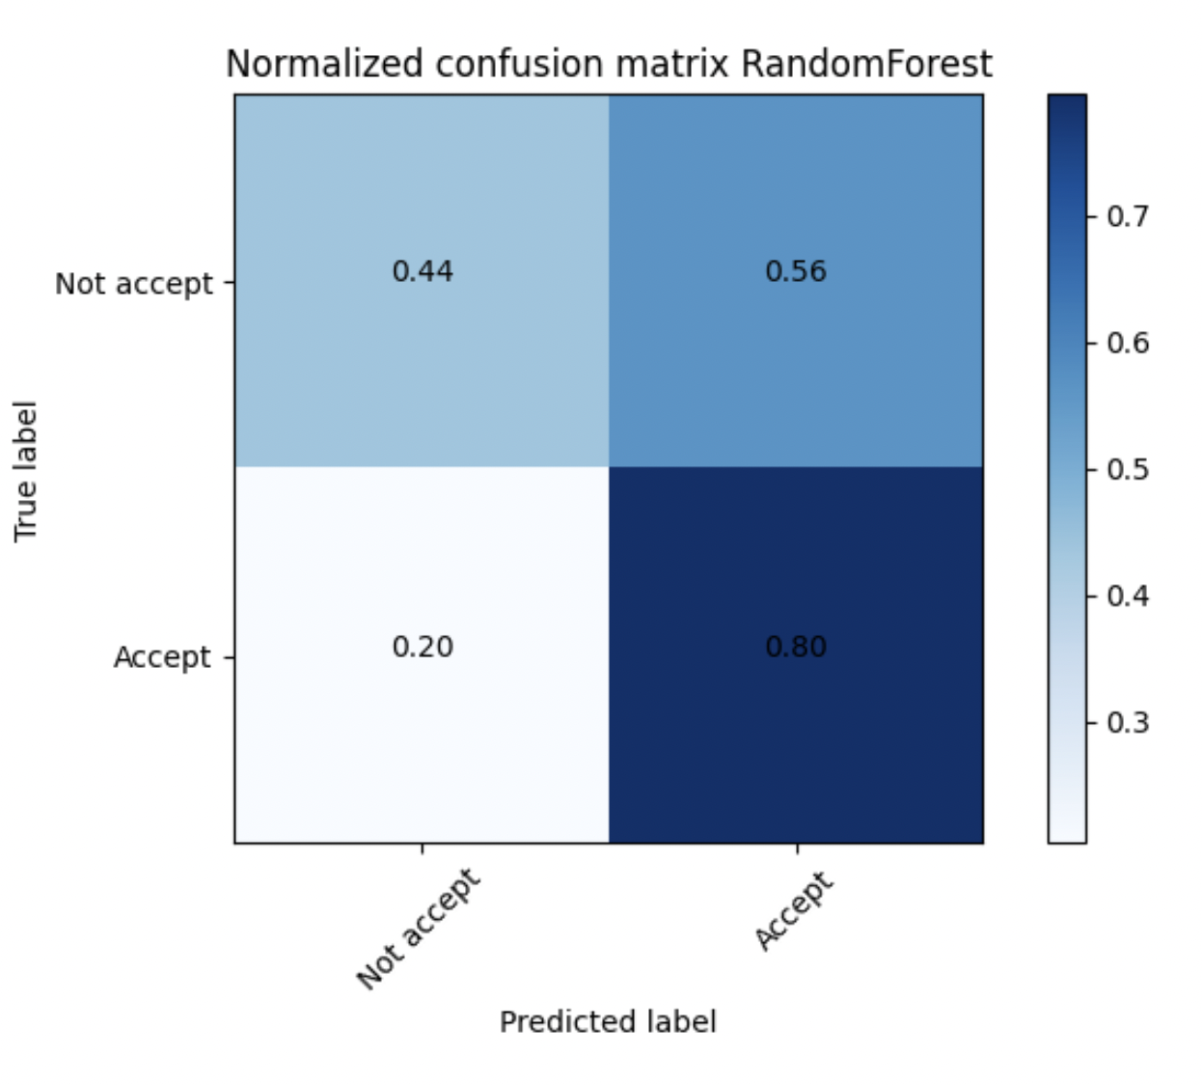
Predictive Analysis
Hyperparameter tuning & Cross-Validation
Random Forest Model
Random Forest Model
n_estimators = 300
max_depth = 3
GridCV for hyperparameter tuning
K-fold cross-validation, k = 10
Cross validation
hit score
accuracy
After tuning the parameter, we can observe that the hit rate of model random forest did not improve.

Slide 13
Recommendation
We Suggest Using Random Forest Model in Predicting the Mortgage Loan Approval
Based on the findings from EDA & predictive analysis, the marketing department should consider the following guidelines for a target group when conducting a marketing campaign:
In general, the marketing department should target applicants with a high-income ratio because it is more sensible that applicants with a high income to the loan amount get accepted
The applicant with a co-applicant yield a higher chance of getting the application accepted, which is why the marketing department should target applicants who are not single or live alone. However, the dataset did not include these factors, so having this type of data in the application is highly recommended
Considering the loan purpose and property type factors, the marketing department should emphasize targeting families with multifamily and 1-4 family property types
However, it seems that applicant background information (sex, race, ethnicity) and the property location (state) have less importance in predicting the approval
⇒ To conclude, the marketing department could conduct a marketing campaign targeting families searching to purchase multifamily or 1-4 family properties. Furthermore, the marketing campaign tone should also emphasize the refinancing factor, meaning that the campaign could educate families on how they can save money or get a better interest rate by refinancing their mortgage loans.

Slide 14
Discussions and Limitations
Improving the model through trial and errors
The modeling process was not straightforward as it required a lot of trial and errors
Examining each features required iterations in the process for improving the model performance
Only the use of two models were planned to be used this project, boosted decision tree models were later introduced in this project
Lasso shrinked all coefficients to 0, suggesting that our variables might not be good predictors. Furthermore, trying a very small lambda caused a heavy workload on CPU
The hyperparameter tuning did not improve the performance noticeably
Computational efficiency
Running LightGBM caused computational crashes and heavy workload on CPU
Limitations
The elimination of variables might have influenced the model performance as some combinations may have predicted our target variable better. Moreover, the cost-benefit framework may vary depending on the fee and commissions set by the companies.

